Slide 1

Our Community
2021

Slide 2
Our Mission
Marshalltown More Than Ever is our
Past
Present
Future
Through innovation, imagination, and enthusiasm we’re building on our history with eyes to the future!

Slide 3
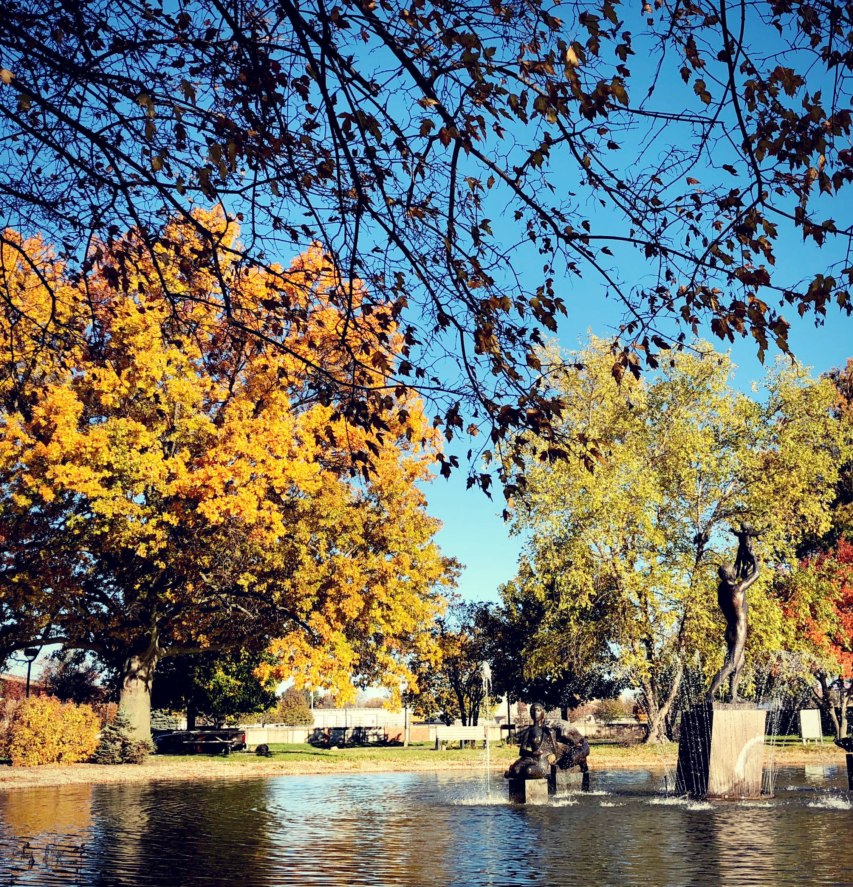
Live Here
Midwestern values with a global vibe
Beautiful neighborhoods + increased living options
Expanding business growth + healthy economy
Schools driven by STEM, innovation, and global diversity
Quality healthcare close to home
Vibrant arts + culture
Thriving recreation + public parks
Civic leadership + public service

Slide 4
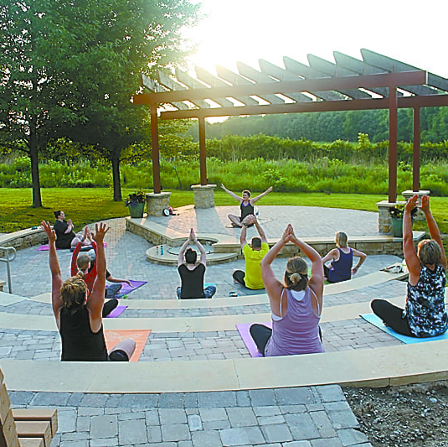
Play Here
Big enough for amenities + small enough for lasting relationships
Year-round recreation
Art galleries + public art
Theater
Hiking + biking trails
Public parks
Aquatic center
Golf courses

Slide 5


Learn Here
Education is the key to the vitality of our community
Innovation, technology, and diversity are the hallmarks of learning
State leader in creating relationships between business and education
STEM, technology, diversity + global awareness drive public school curriculum
High school + college partnerships to earn college credit
Marshalltown Community College academics + athletics
Nationally recognized public library

